Slide 1
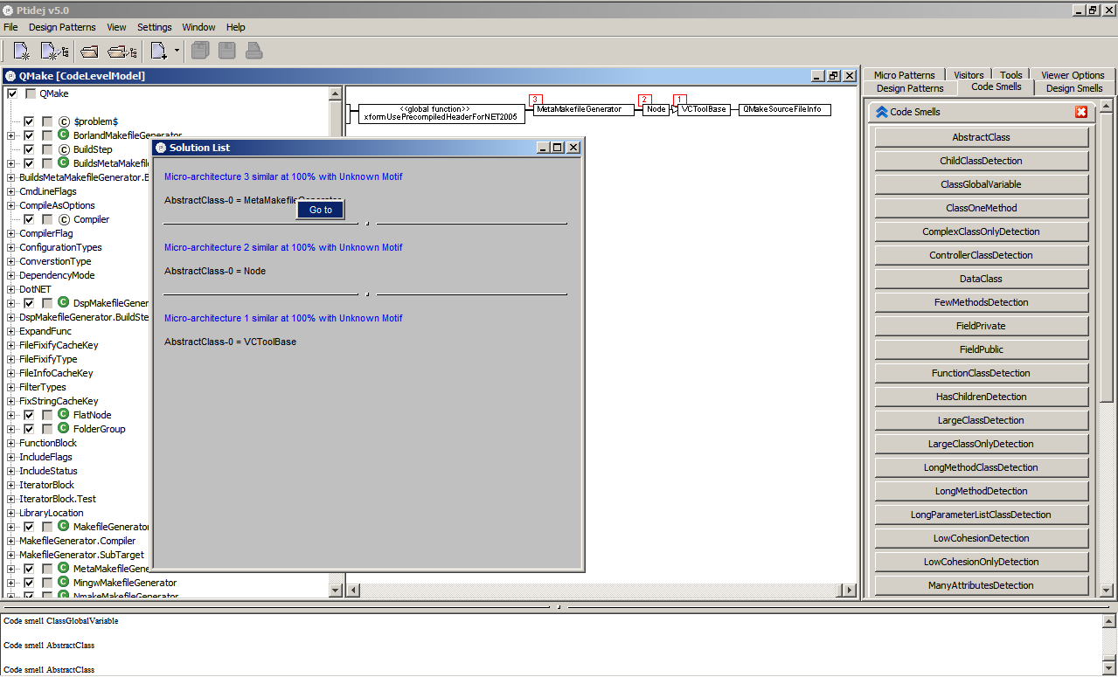
CanvasListener
CanvasListener
+ AbstractRepresentationWindow.setVisibleElements(int)

